Slide 1
Lecture : Project Integration Management

Slide 2
Learning Objectives
Describe an overall framework for project integration management as it relates to the other project management knowledge areas and the project life cycle.
Explain the strategic planning process and apply different project selection methods.
Explain the importance of creating a project charter to formally initiate projects.
Discuss the process of creating a preliminary project scope statement.

Slide 3
Learning Objectives
Describe project management plan development, including content, using guidelines and templates for developing plans, and performing a stakeholder analysis to help manage relationships.
Explain project execution, its relationship to project planning, the factors related to successful results, and tools and techniques to assist in project execution.
Describe the process of monitoring and controlling project work.

Slide 4
Learning Objectives
Understand the integrated change control process, planning for and managing changes on information technology projects, and developing and using a change control system.
Explain the importance of developing and following good procedures for closing projects.
Describe how software can assist in project integration management.

Slide 5
What is Project Integration Management?
Project integration management involves coordinating all the other project management knowledge areas throughout a project’s life cycle.
Integration ensures that all the elements of a project come together at the right times to complete a project successfully.

Slide 6
Project Integration Management Processes
Develop the project charter: Work with stakeholders to create the document that formally authorizes a project—the charter.
Develop the preliminary project scope statement: Work with stakeholders, especially users of the project’s products, services, or results, to develop the high-level scope requirements and create a preliminary project scope statement.
Develop the project management plan: Coordinate all planning efforts to create a consistent, coherent document—the project management plan.

Slide 7
Project Integration Management Processes (cont’d)
Direct and manage project execution: Carry out the project management plan by performing the activities included in it.
Monitor and control the project work: Oversee project work to meet the performance objectives of the project.
Perform integrated change control: Coordinate changes that affect the project’s deliverables and organizational process assets.
Close the project: Finalize all project activities to formally close the project.

Slide 8
The Key to Overall Project Success: Good Project Integration Management
Coordinating all of the people, plans, and work required to complete a project
Focus on the big picture of the project and steer the project team toward successful completion
Make final decision when there are conflicts among project goals or people involved
Communicate key project information to top management

Slide 9
Interface Management
Interface management involves identifying and managing the points of interaction b/w various elements of the project.
The number of interfaces can increase exponentially as the number of people involved in the project increase.
The most important jobs of a project manager is to establish and maintain good communication and relationships across organizational interfaces

Slide 10
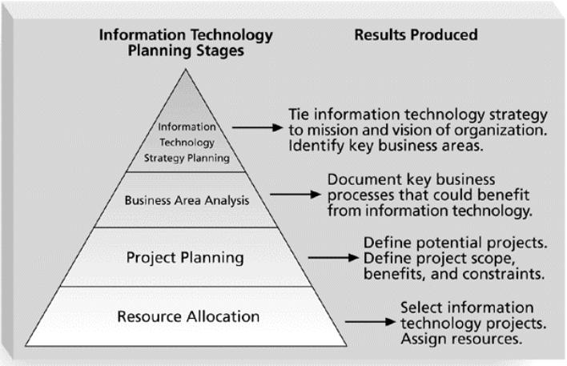
Strategic Planning and Project Selection
Identifying Potential Projects
Deciding what projects to do in the first place

Slide 11
Strategic Planning and Project Selection
Strategic planning involves determining long-term objectives, predicting future trends, and projecting the need for new products and services.
Organizations often perform a SWOT analysis:
Strengths, Weaknesses, Opportunities, and Threats

Slide 12
Methods for Selecting Projects
There is usually not enough time or resources to implement all projects.
Methods for selecting projects include:
Focusing on broad organizational needs.
Categorizing information technology projects.
Performing net present value or other financial analyses.
Using a weighted scoring model.
Implementing a balanced scorecard.

Slide 13
Focusing on Broad Organizational Needs
It is often difficult to provide strong justification for many IT projects, but everyone agrees they have a high value.
“It is better to measure gold roughly than to count pennies precisely.”
Three important criteria for projects:
There is a need for the project.
There are funds available for the project.
There is a strong will to make the project succeed.

Slide 14
Categorizing IT Projects
One categorization assesses whether the project provides a response to:
A problem
An opportunity
A directive
Another categorization is based on the time it will take to complete a project or the date by which it must be done.
Another categorization is the overall priority of the project.

Slide 15
Financial Analysis of Projects
Financial considerations are often an important aspect of the project selection process.
Three primary methods for determining the projected financial value of projects:
Net present value (NPV) analysis
Return on investment (ROI)
Payback analysis

Slide 16
Net Present Value Analysis
Net present value (NPV) analysis is a method of calculating the expected net monetary gain or loss from a project by discounting all expected future cash inflows and outflows to the present point in time.
Projects with a positive NPV should be considered if financial value is a key criterion.
The higher the NPV, the better.

Slide 17
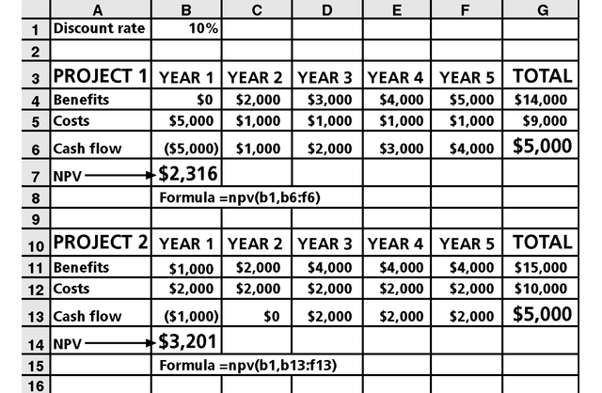
Figure 4-2. Net Present Value Example
Note that
totals are
equal, but
NPVs are
not because of the time value of money.

Slide 18
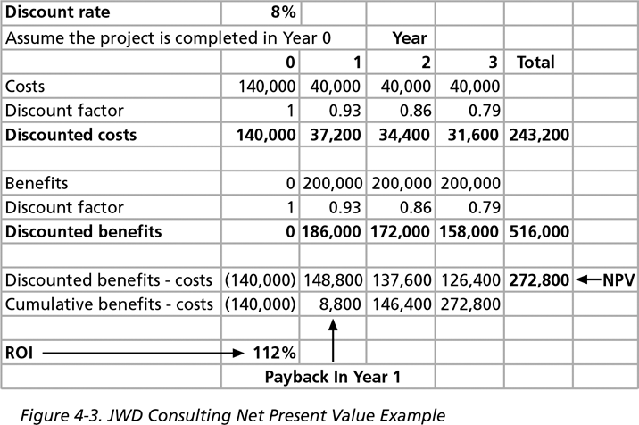
Figure 4-3. JWD Consulting NPV Example
Multiply
by the
discount
factor each
year, then subtract costs from cumulative
benefits to
get NPV.
Note: See the template called business_case_financials.xls.

Slide 19
NPV Calculations
Determine estimated costs and benefits for the life of the project and the products it produces.
Determine the discount rate (check with your organization on what to use).
Calculate the NPV (see text for details).
Some organizations consider the investment year as year 0, while others consider it year 1. Some people enter costs as negative numbers, while others do not. Make sure to identify your organization’s preferences.

Slide 20
Return on Investment
Return on investment (ROI) is calculated by subtracting the project costs from the benefits and then dividing by the costs.
ROI = (total discounted benefits - total discounted costs) / discounted costs
The higher the ROI, the better.
Many organizations have a required rate of return or minimum acceptable rate of return on investment for projects.
Internal rate of return (IRR) can by calculated by setting the NPV to zero.

Slide 21
Payback Analysis
Another important financial consideration is payback analysis.
The payback period is the amount of time it will take to recoup, in the form of net cash inflows, the total dollars invested in a project.
Payback occurs when the cumulative discounted benefits and costs are greater than zero.
Many organizations want IT projects to have a fairly short payback period.

Slide 22
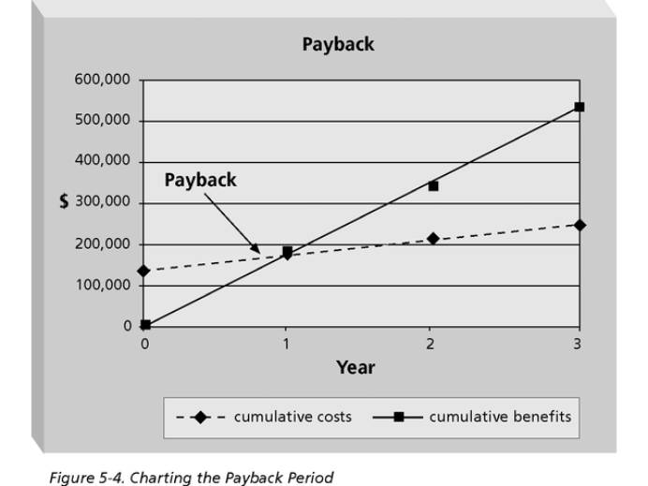
Figure 4-4. Charting the Payback Period
Excel file

Slide 23
Weighted Scoring Model
A weighted scoring model is a tool that provides a systematic process for selecting projects based on many criteria.
Steps in identifying a weighted scoring model:
Identify criteria important to the project selection process.
Assign weights (percentages) to each criterion so they add up to 100 percent.
Assign scores to each criterion for each project.
Multiply the scores by the weights to get the total weighted scores.
The higher the weighted score, the better.

Slide 24
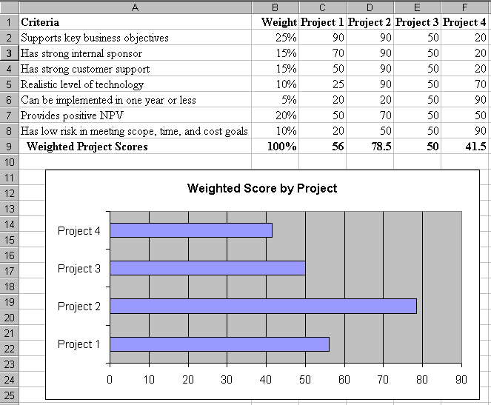
Figure 4-5. Sample Weighted Scoring Model for Project Selection

Slide 25
Implementing a Balanced Scorecard
Drs. Robert Kaplan and David Norton developed this approach to help select and manage projects that align with business strategy.
A balanced scorecard is a methodology that converts an organization’s value drivers, such as customer service, innovation, operational efficiency, and financial performance, to a series of defined metrics.
See www.balancedscorecard.org for more information.

